Slide 1
CASE STUDY: ANOMALY DETECTION With Industrial PC-based Energy Measurement Framework
PRESENTED BY
Bhagyashree Popat Zaware
Eduardo Guandulain Juárez
Muhammad Munam Uddin Farooqui
Nnamdi Ogbonnaya Odii
Yuganshu Whadhwa
Rohit Arunachalam Gopinath

Slide 2
Agenda
Overview
Data Acquisition
Communication
Algorithm
Results

Slide 3
Overview
Problem Statement
The objective is to develop and implement an anomaly detection solution to identify
real-time failures in power systems.
Solution Concept
BECKHOFF Industrial PC and TwinCAT 3 to monitor and analyze power signals.
Algorithm to detect anomalies.
Expected Benefits
Improved efficiency, reduced downtime, corrective maintenance.

Slide 4
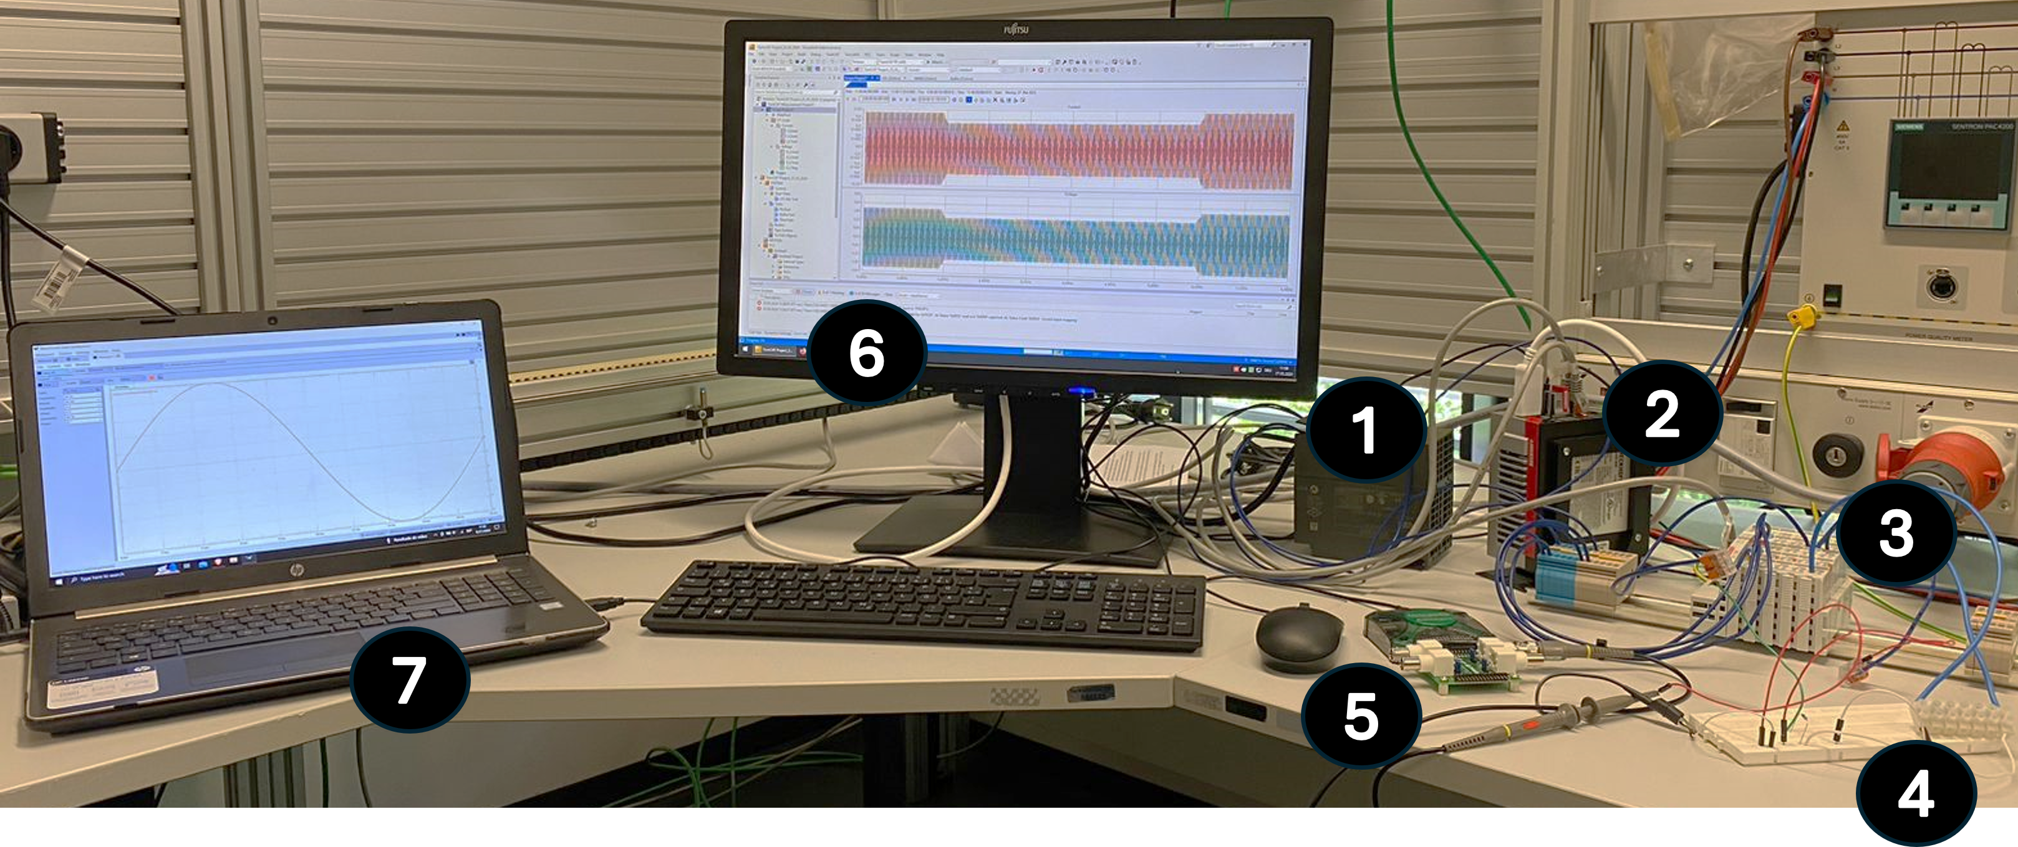
Experimental Setup
24V DC Power Supply
Beckhoff’s IPC hosting TwinCAT 3
Beckhoff’s I/O terminals
EK 1100
EL 3783
220Ω resistive load on a breadboard
Digilent Analog Discovery 2
Computer monitor
Waveform signal generator

Slide 5
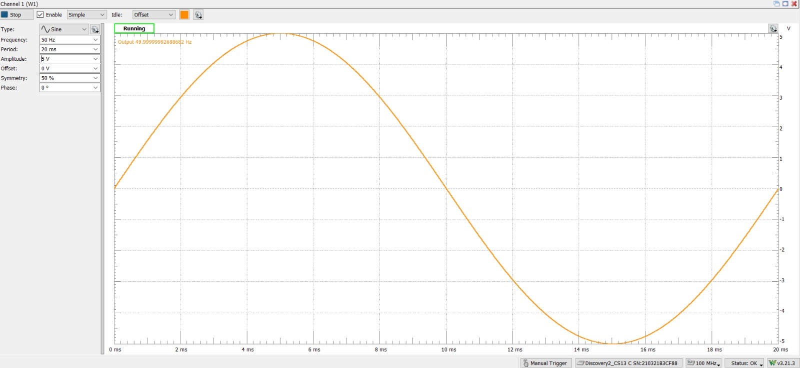
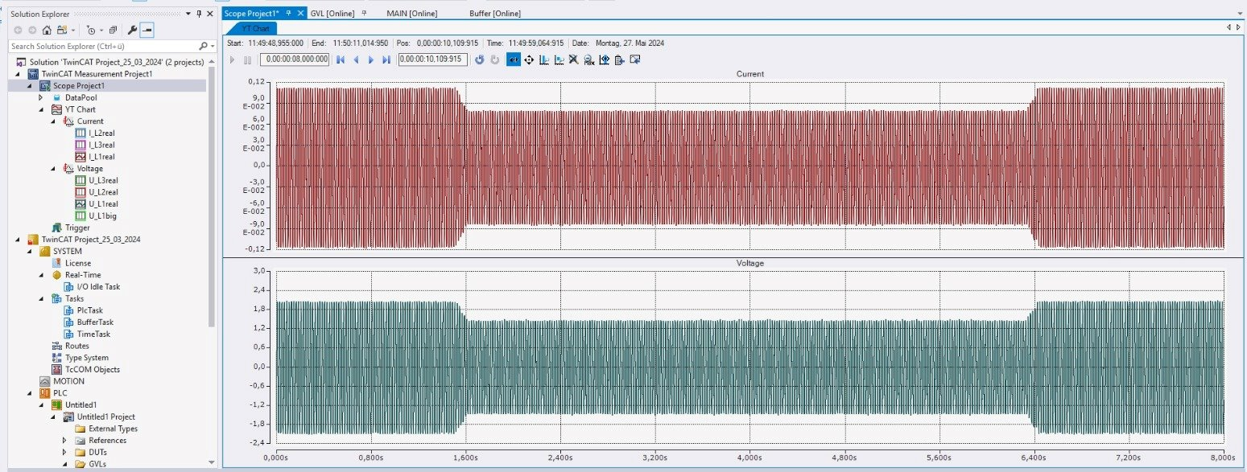
Data Acquisition
WaveForms Generation Software
Data acquisition using TwinCAT 3

Slide 6
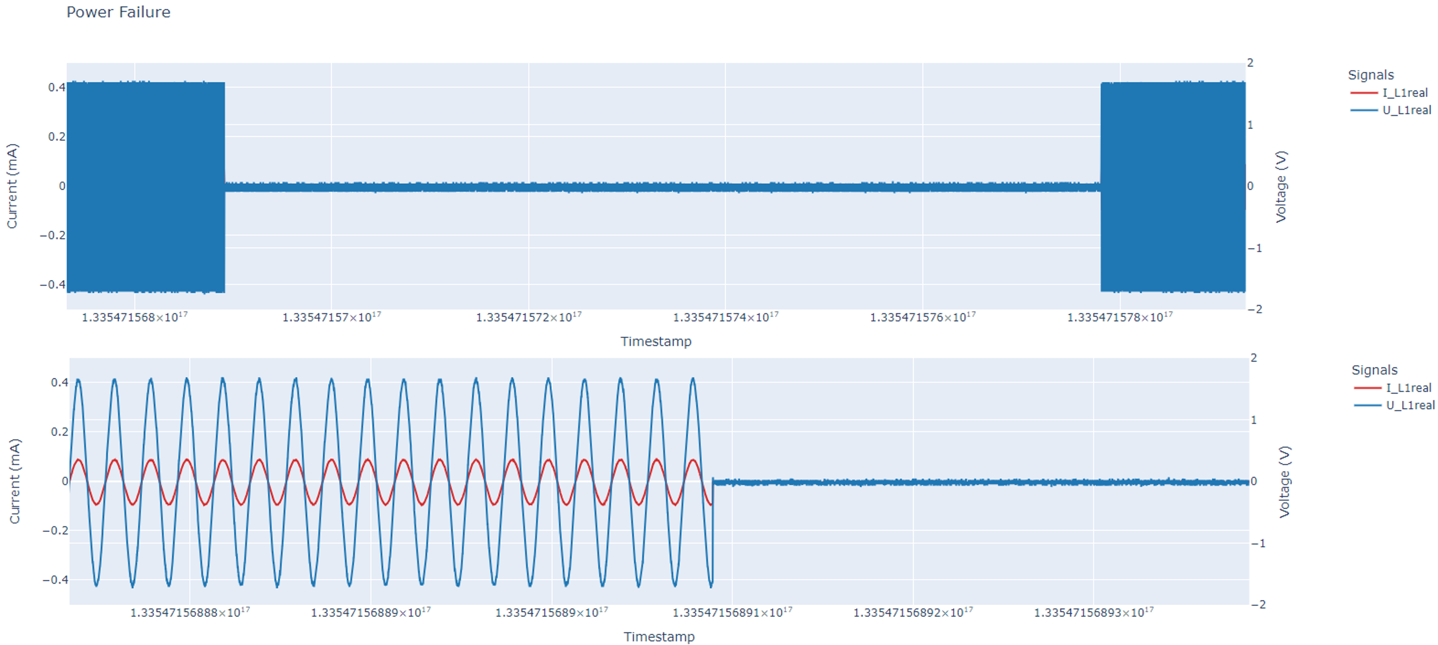
Power Failure
Value from AnalogDiscovery2
= 4V - 0v - 4v
Voltage at the terminals
= 1,65V - 0v - 1,65V
Time
= 15s - 90s - 15s
Voltage Magnitude < 0.1 pu for 3s - 1min

Slide 7
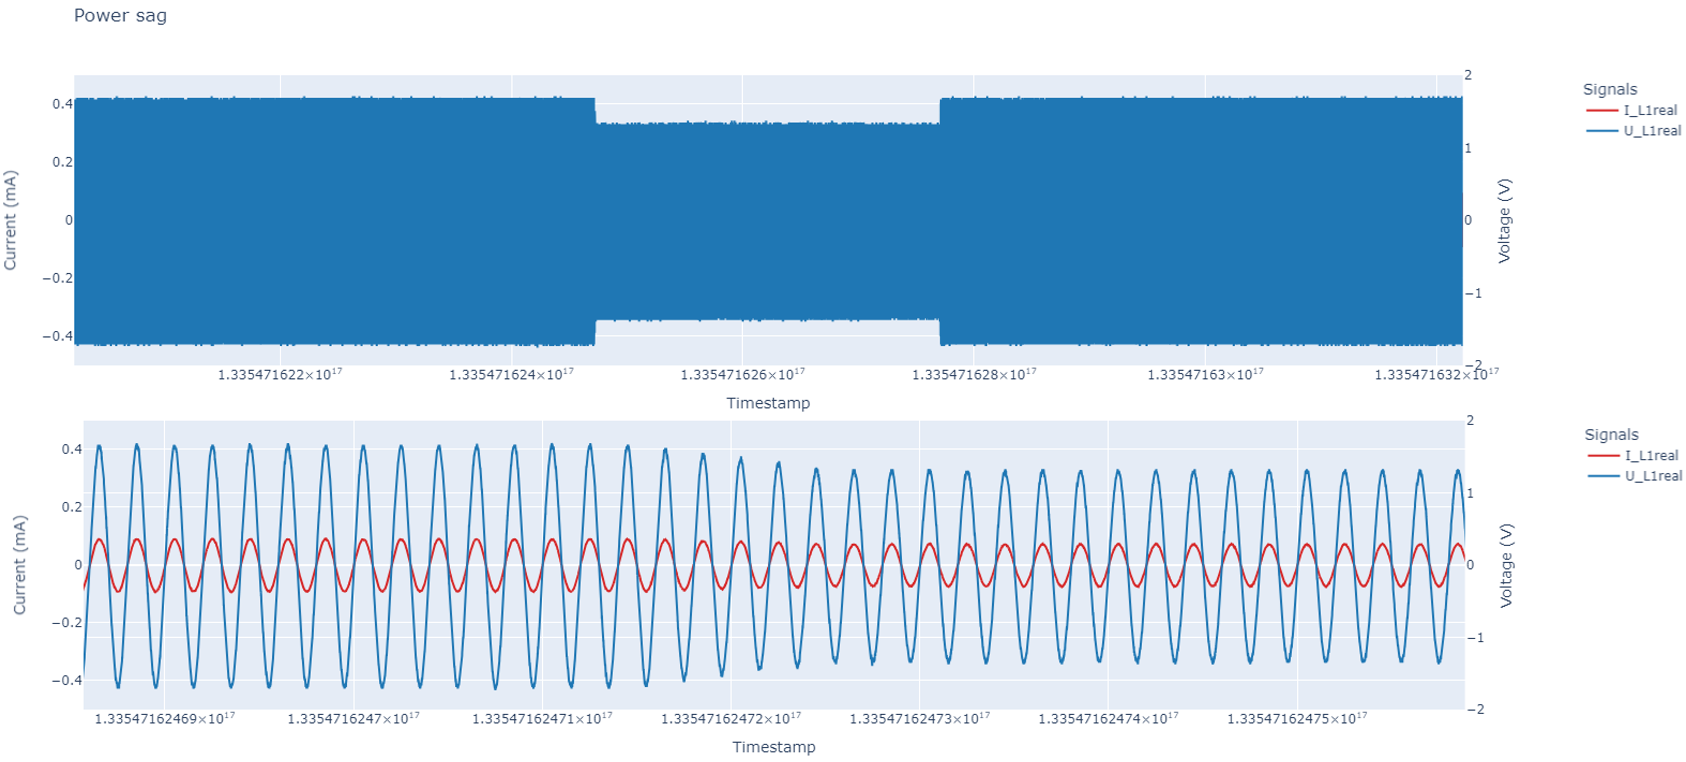
Voltage Sag
Value from AnalogDiscovery2
= 4 V - 3.2V - 4v
Voltage at the terminals
= 1.65V - 1.32V - 1.65V
Time
= 45s - 30s - 45s
Voltage Magnitude: 0.1 - 0.9pu for 3s - 1min

Slide 8
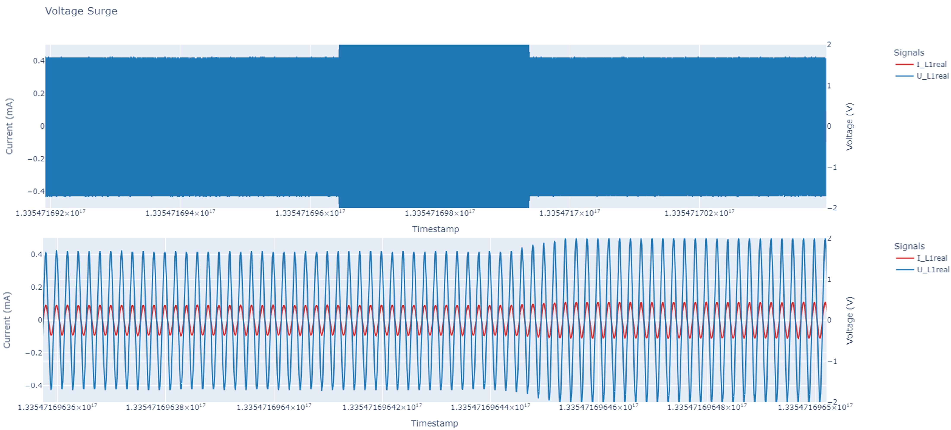
Voltage Swell
Value from AnalogDiscovery2
= 4 V - 4.8v - 4v
Voltage at the terminals
= 1.65V - 1.98V - 1.65V
Time
= 45s - 30s - 45s
Voltage Magnitude
1.1 - 1.2 pu for 3s - 1min

Slide 9
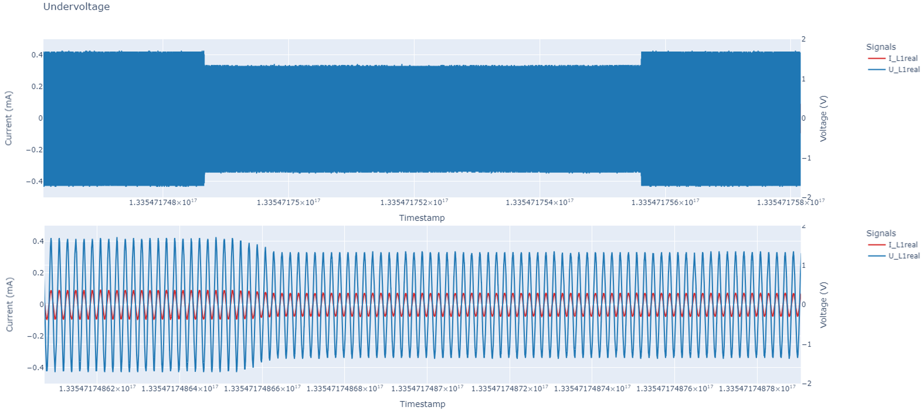
Undervoltage
Value from AnalogDiscovery2
= 4 V - 3.2v - 4v
Voltage at the terminals
= 1.65V - 1.32V - 1.65V
Time
= 25s - 70s - 25s
Voltage Magnitude
0.8 - 0.9 pu for > 1min

Slide 10
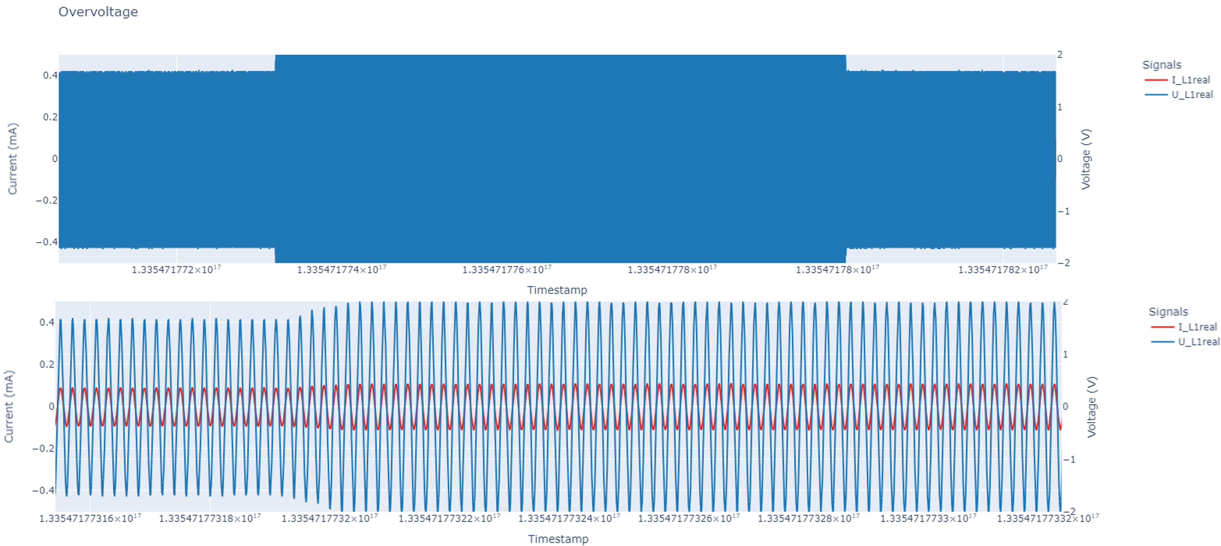
Overvoltage
Value from AnalogDiscovery2
= 4 V - 4.8v - 4v
Voltage at the terminals
= 1.65V - 1.98V - 1.65V
Time
= 25s - 70s - 25s
Voltage Magnitude:
1.1 - 1.2 pu for > 1min

Slide 11
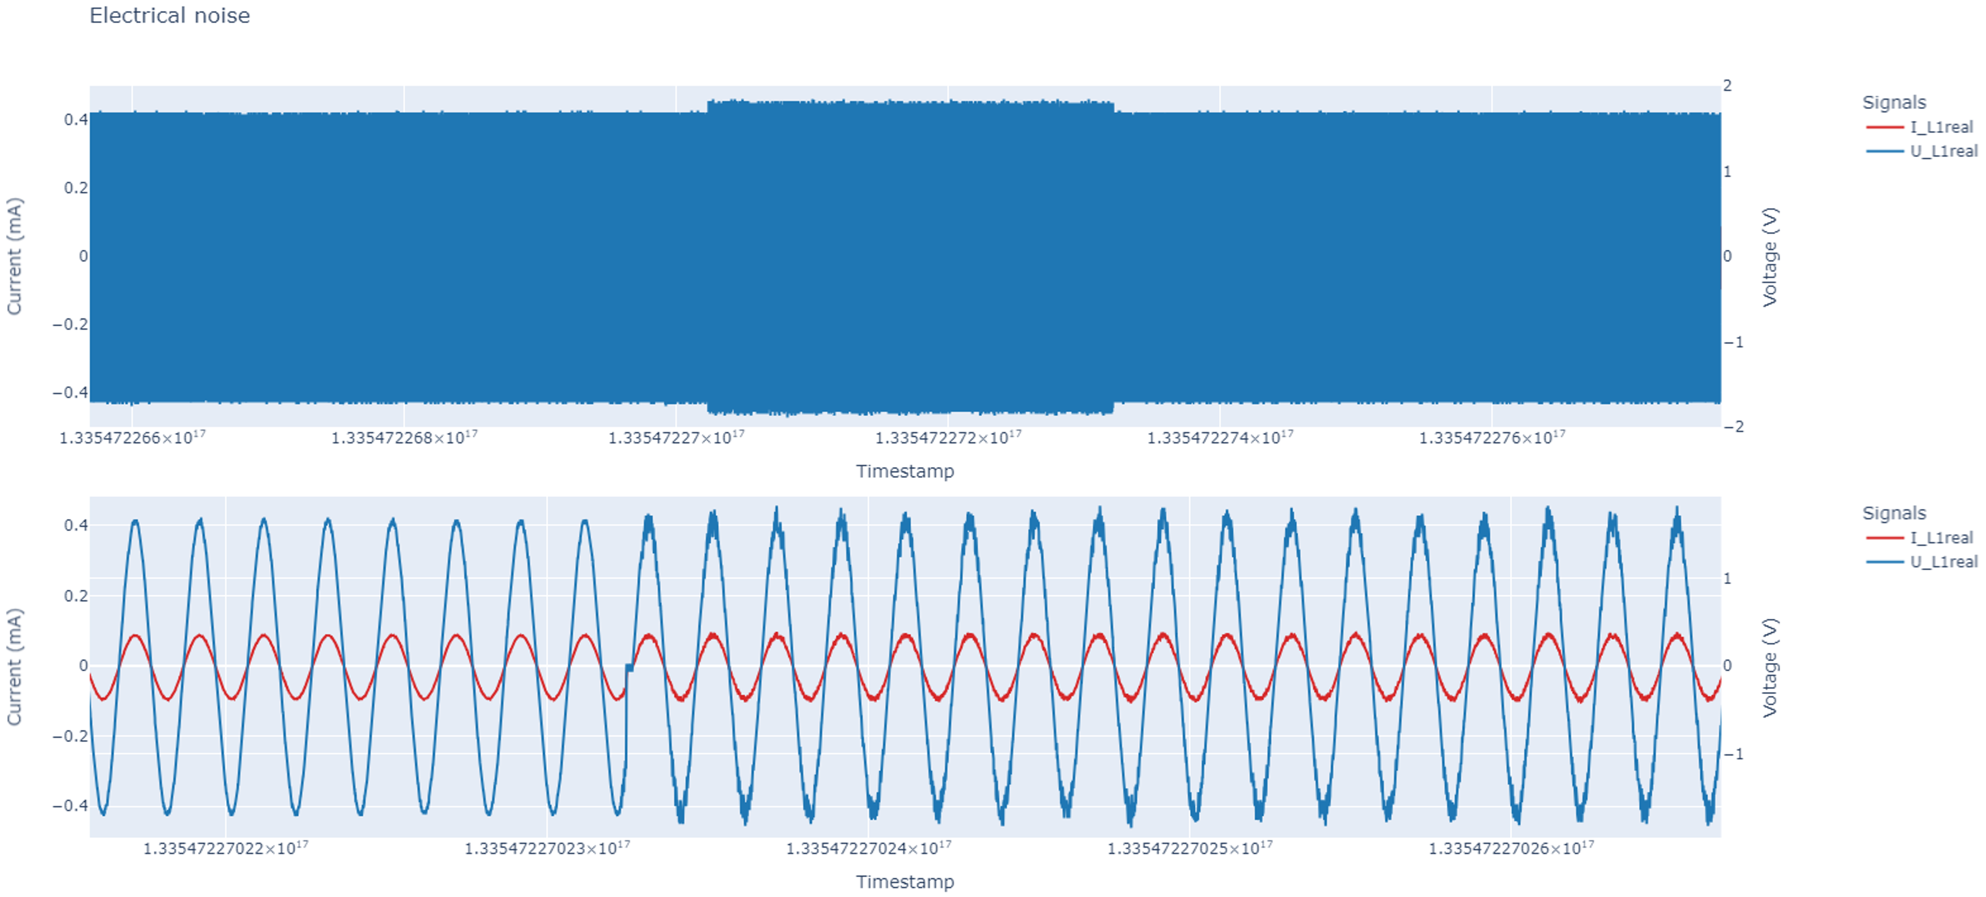
Electrical Noise
Value from AnalogDiscovery2
= 4 V - 4v / 50Hz with 10kHz - 4v
Value at the terminals
= 1.65 V - 1.65v / 50Hz with 10kHz - 4v
Time
= 45s - 30s - 45s

Slide 12
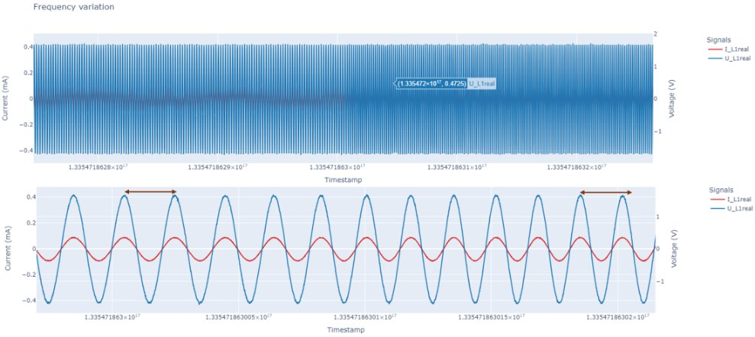
Frequency Variation
Value from AnalogDiscovery2
= 4V / 50Hz - 4V / 60Hz - 4V / 50Hz
Voltage at the terminals
= 1.65 / 50Hz - 1.65V / 60Hz - 1.65V / 50Hz
Time
= Same for > 10 s

Slide 13
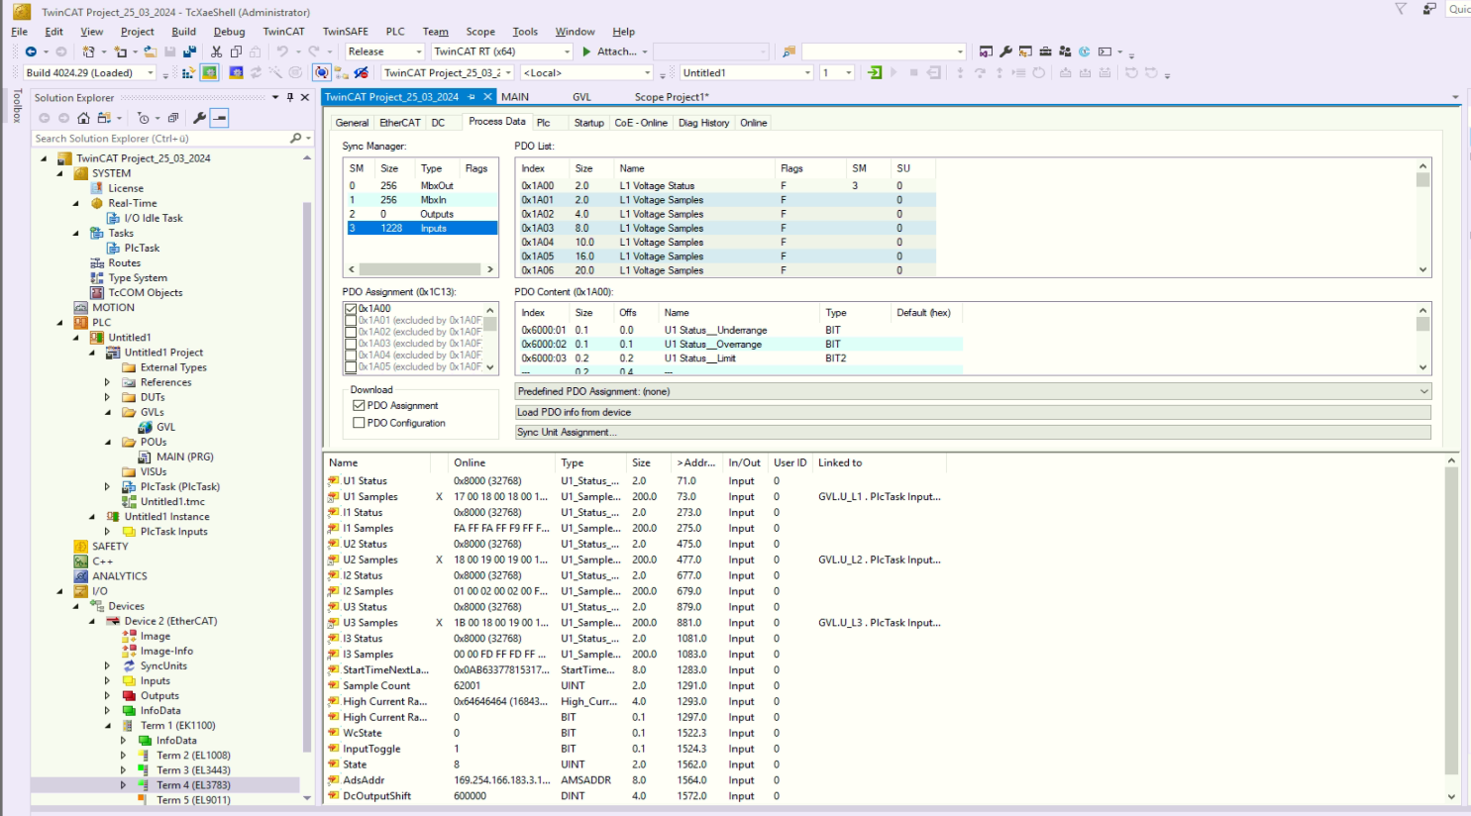
TwinCAT 3 Setup

Slide 14
Communication
TWINCAT 3
PYTHON
(Data Acquisition)
PYTHON
(Anomaly Detection)
OVERSAMPLING MODULE
Reads Data every 50µs and stores in
an array of 100 values
PLC
PLC fetches data every 5ms.
Array of 100 values
PyADS
Read and write
Notification based
ANOMALY DETECTION ALGORITHM
For Anomoly detection we need 10 cycles of data(4000 data samples) according to IEEE standard.
Communication

Slide 15
Communiction
Approaches:
ADS- PyADS Read/Write
Buffer Creation
ADS Notification

Slide 16
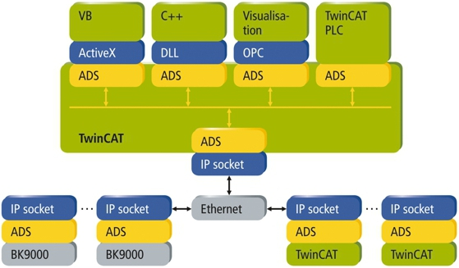
ADS Communication
Adapted from https://infosys.beckhoff.com/english.php?content=../content/1033/cx8190_hw/5091854987.html&id=

Slide 17
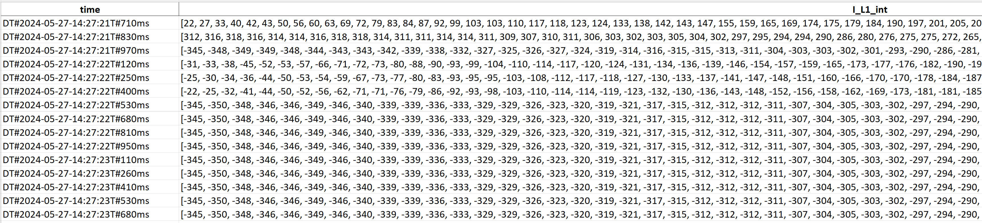
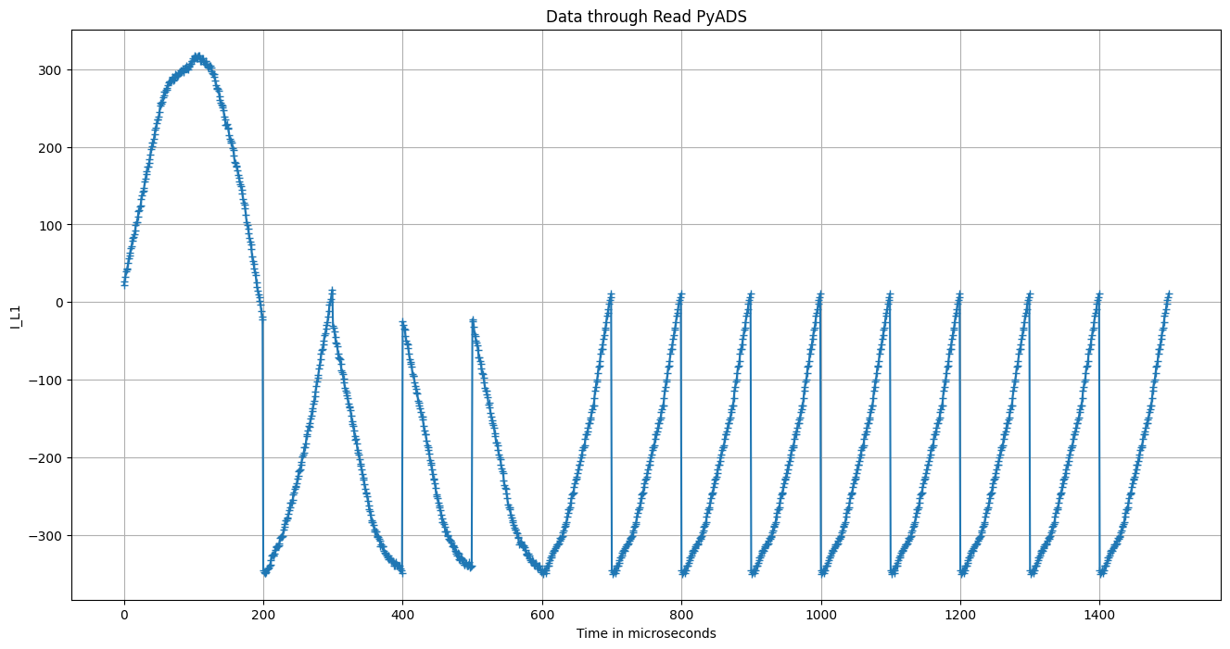
PyADS Read/ Write

Slide 18
Buffer With PyADS
FB_MemRingBuffer: FIFO Buffer
Implementation Unsuccessful
FB_MemStackBuffer: LIFO Buffer
Not Useful in our Case
Buffer through loop and different PLC Tasks

Slide 19
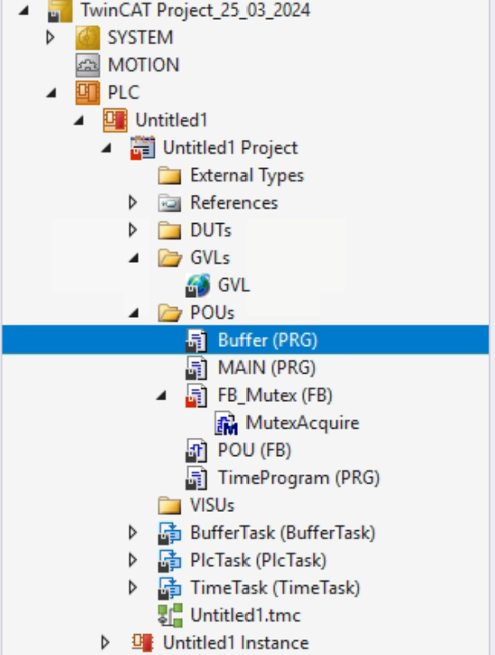
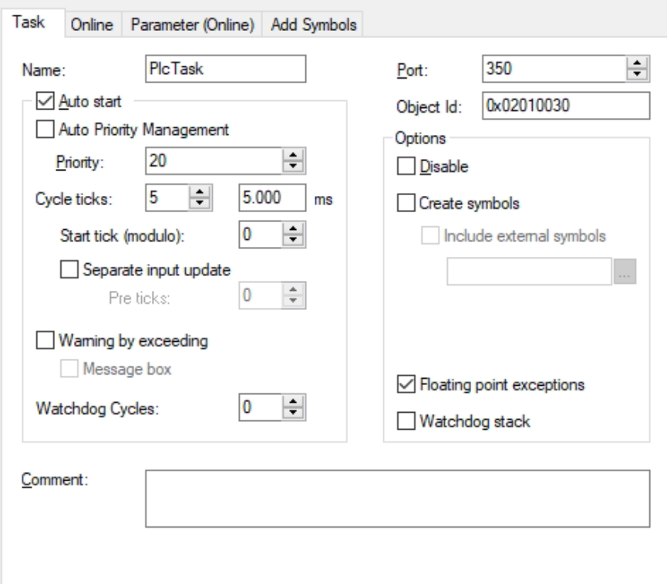
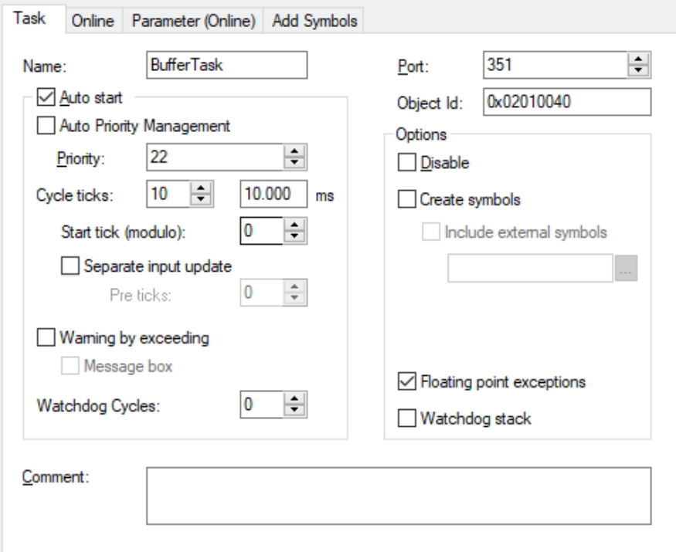
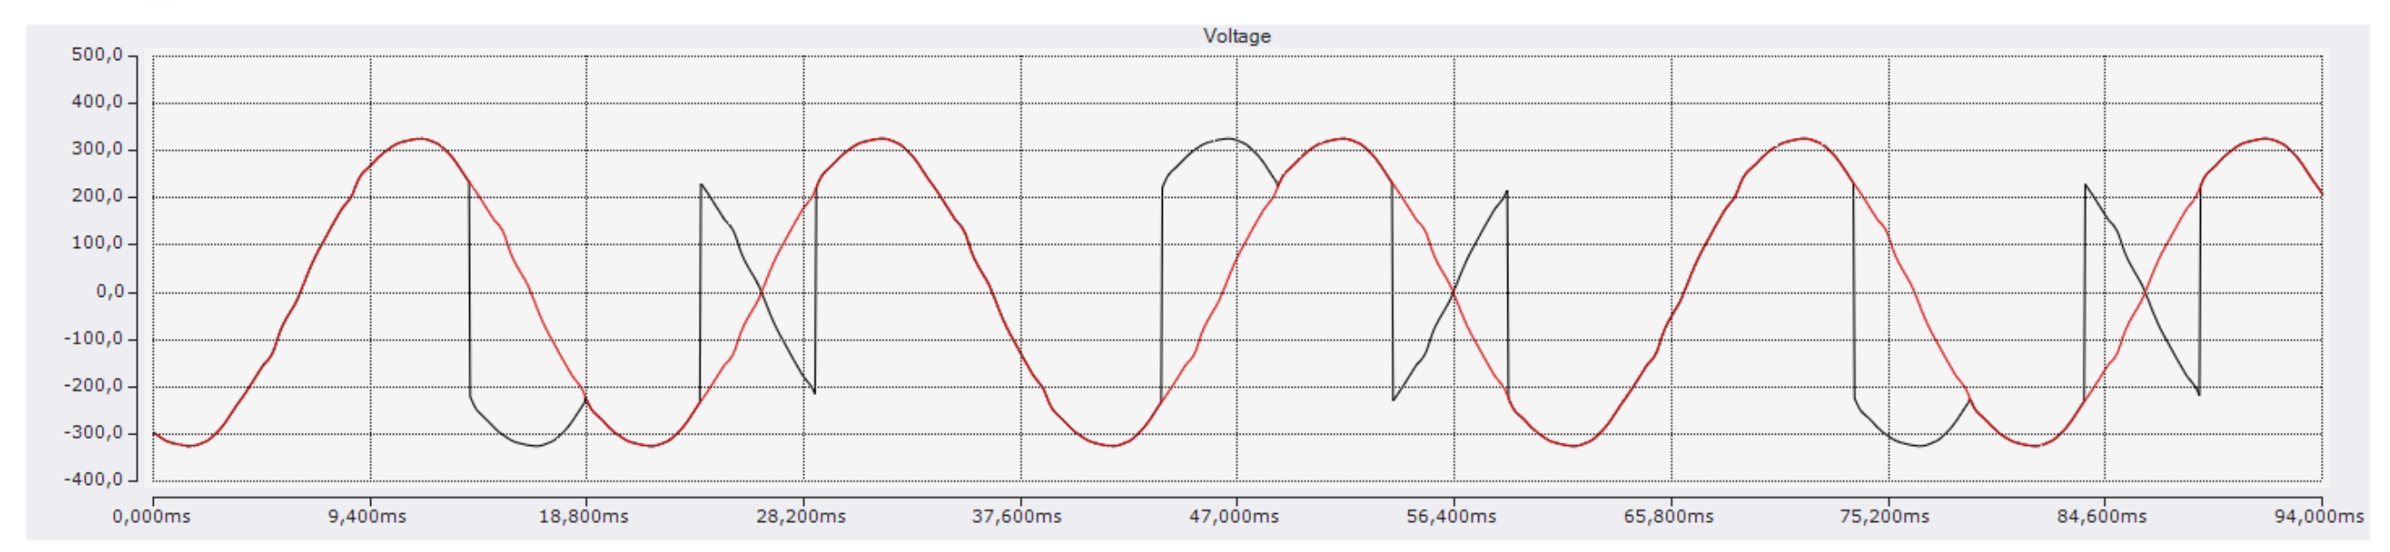
Buffer Creation

Slide 20
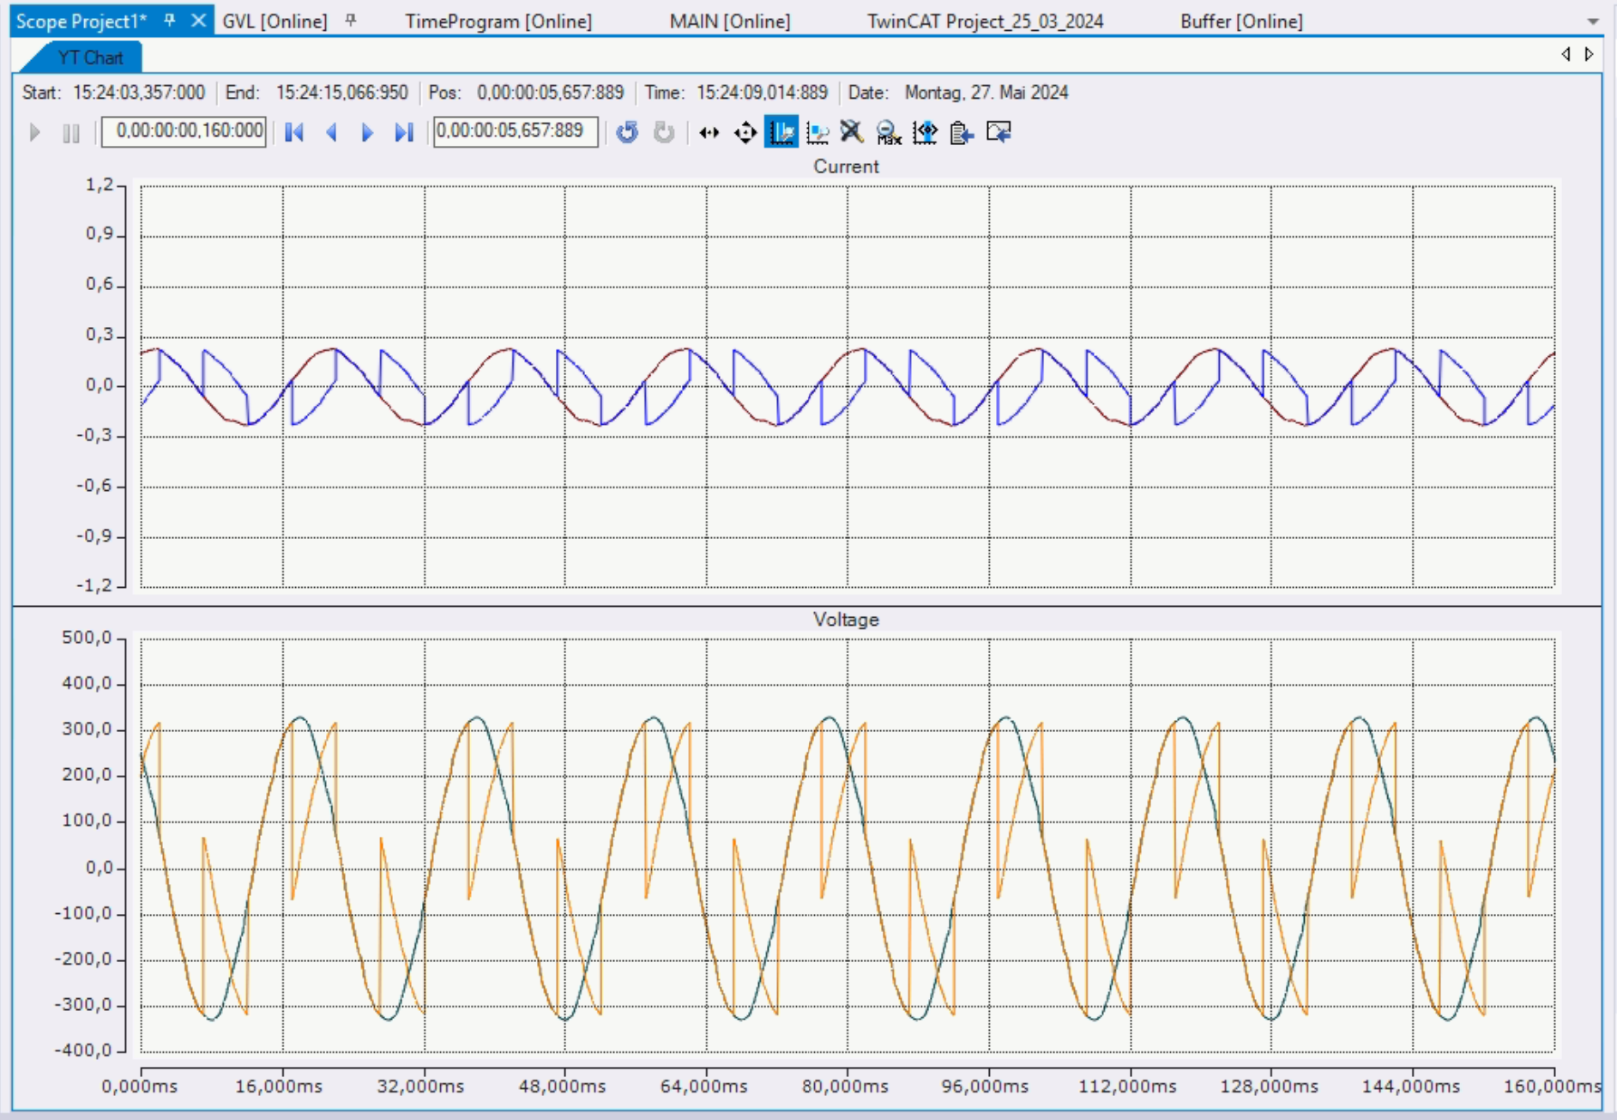
Buffer Results

Slide 21
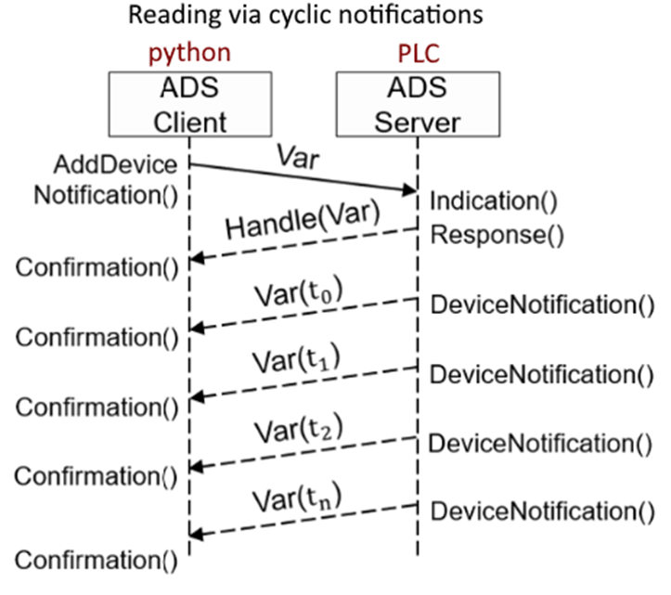
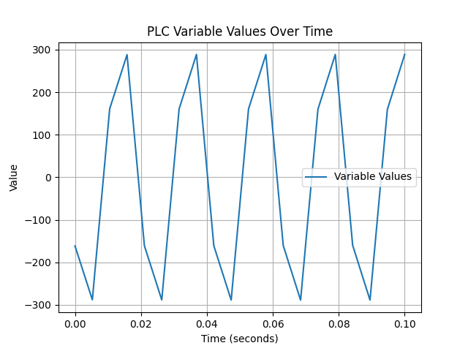
ADS Notification
Communication via notifications instead of individual
read requests
PUSH instead of PULL
Unsuccessful implementation

Slide 22

Comparison and direction for future
ADS notifications
Data Buffer
Data loss ??
Time issue ??
TwinCAT 3 expertise ??
ADS read/write

Slide 23

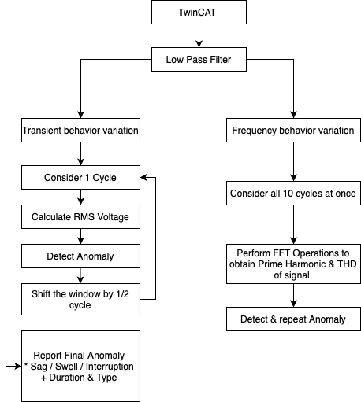
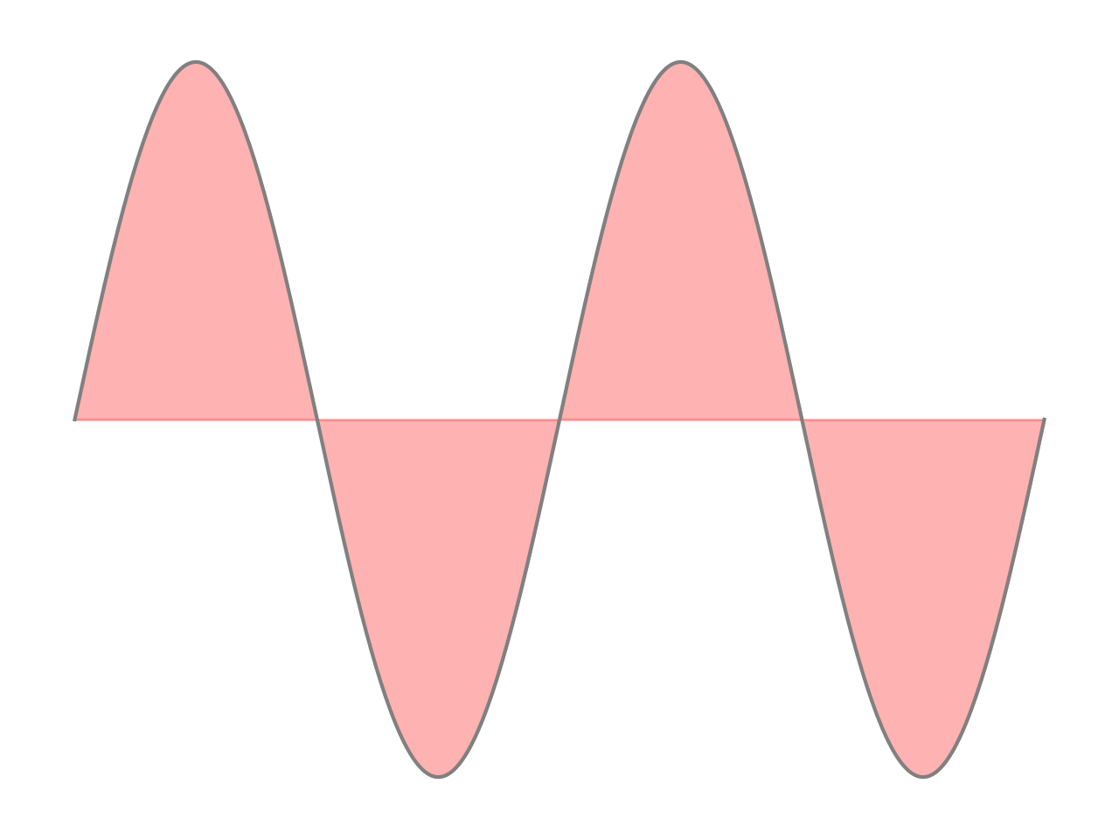
Overview Of The Algorithm
10 Cycle Window for 50 Hz
As per IEEE Standard 1564-2014
V, I Signals (Noisy)
V, I Signals (Smooth)
Transient Behavior Variations
Interruptions
Voltage Sag
Voltage Swell
Frequency Behavior Variations
Prime Harmonic Variation
THD Calculation

Slide 24
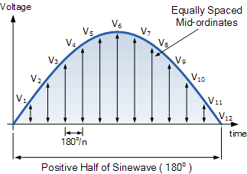
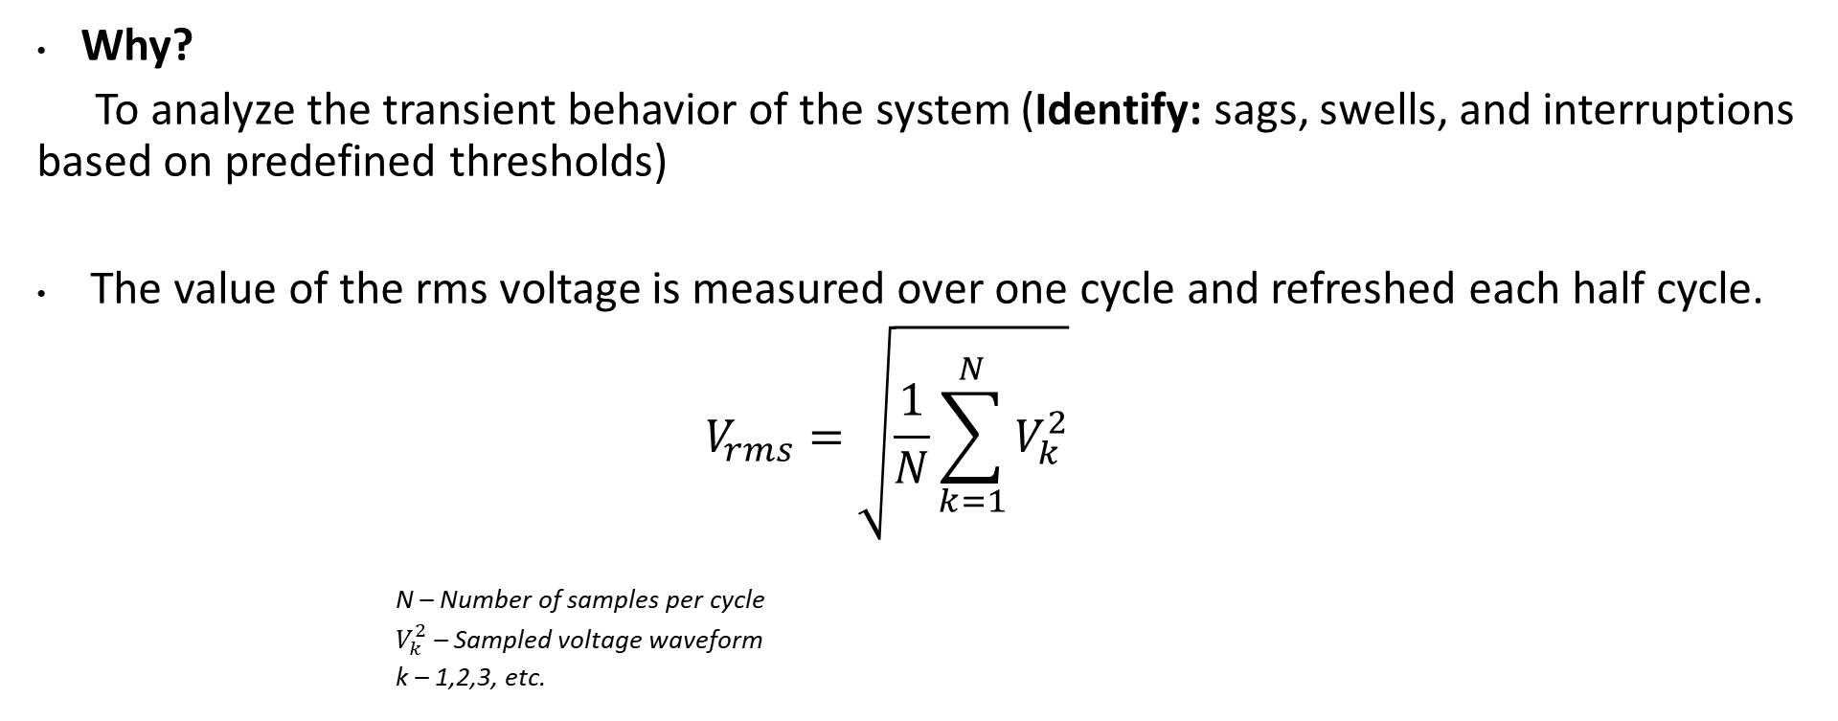
Calculation Of Rms Voltage
As per IEEE Standard 1564-2014
Why?
To analyze the transient behavior of the system (Identify: sags, swells, and interruptions based on predefined thresholds)
The value of the rms voltage is measured over one cycle and refreshed each half cycle.
$$V_{rms}=\sqrt{\frac{1}{N}\sum_{k=1}^{N}{V_{k}^{2}}}$$
N – Number of samples per cycle
$V_{k}^{2}$ – Sampled voltage waveform
k – 1,2,3, etc.

Slide 25
Detection Of Transient Anomalies
As per IEEE Standard 1159-2019
S. No | Categories | Typical Duration (Cycles) | Typical Duration (Seconds) | Typical Voltage Magnitude
1 | Short Duration RMS
1.1 | Instantaneous
1.1.1 | Sag | 0.5–30 cycles | 0.01 - 0.6 Seconds | 0.1–0.9 pu
1.1.2 | Swell | 0.5–30 cycles | 0.01 - 0.6 Seconds | >1.1 pu
1.2 | Momentary
1.2.1 | Interruption | 0.5 cycles – 3s | 0.01 - 3 Seconds | < 0.1 pu
1.2.2 | Sag | 30 cycles – 3 s | 0.6 - 3 Seconds | 0.1–0.9 pu
1.2.3 | Swell | 30 cycles – 3 s | 0.6 - 3 Seconds | >1.1 pu
1.3 | Temporary
1.3.1 | Interruption |  | >3 Seconds – 1 Minute | < 0.1 pu
1.3.2 | Sag |  | >3 Seconds – 1 Minute | 0.1–0.9 pu
1.3.3 | Swell |  | >3 Seconds – 1 Minute | >1.1 pu
2 | Long Duration RMS
2.1 | Power Failure |  | > 1 Minute | <0.1 pu
2.2 | Under - Voltage |  | > 1 Minute | 0.1–0.9 pu
2.3 | Over - Voltage |  | > 1 Minute | >1.1 pu

Slide 26
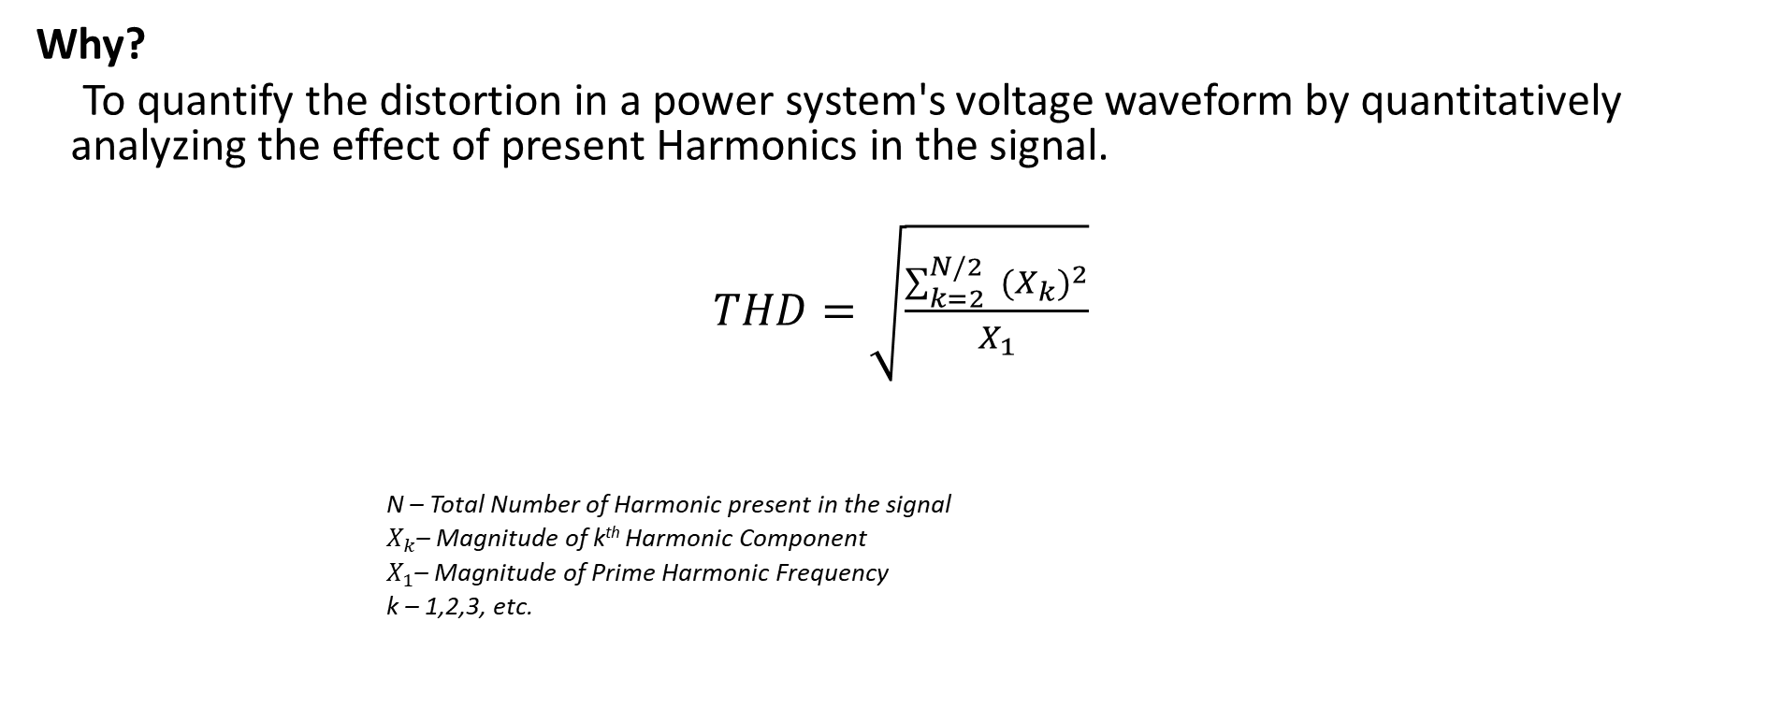
Calculation Of Total Harmonic Distortion (THD)
As per IEEE Standard 519-2014
Why?
To quantify the distortion in a power system's voltage waveform by quantitatively analyzing the effect of present Harmonics in the signal.
$THD=\sqrt{\frac{\sum_{k=2}^{N/2}{ {(X_{k})}^{2}}}{X_{1}}}$
N – Total Number of Harmonic present in the signal
$X_{k}$– Magnitude of k^{th} Harmonic Component
$X_{1}$– Magnitude of Prime Harmonic Frequency
k – 1,2,3, etc.

Slide 27
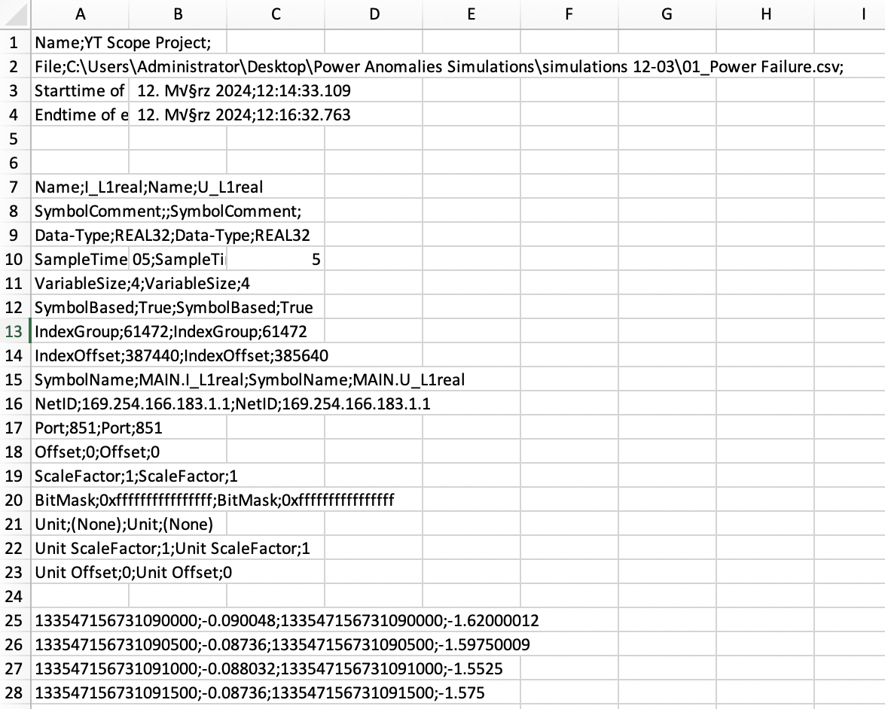
Processing Of Raw Data
Current & Voltage data received from TwinCAT in the form of CSV file.
Name - Time Stamp (LDAP)
I_L1real - Current
U_L1real - Voltage

Slide 28



Converting LDAP Timestamps
Lightweight Directory Access Protocol (LDAP) timestamp.
Represent the number of 100-nanosecond intervals since January 1, 1601 (UTC).
Why ?
Provides high precision - crucial for accurately recording events in time-sensitive applications.
Raw data consist of LDAP Timestamps which is converted to human readable format. (YYYY-MM-DD HH:MM:SS)
Why ?
Data analysis and Visualization.

Slide 29
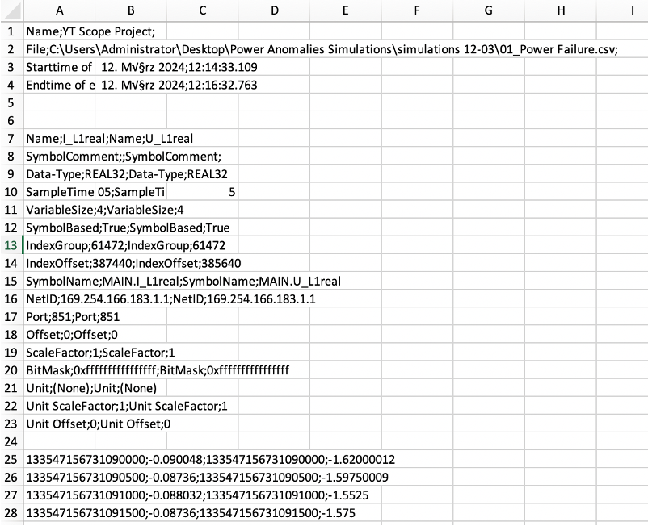

Modifying Time Stamp
Raw data from TwinCAT is cleaned by
dropping null values, and other
columns are removed.
Timestamp column is renamed
from Name > Time

Slide 30
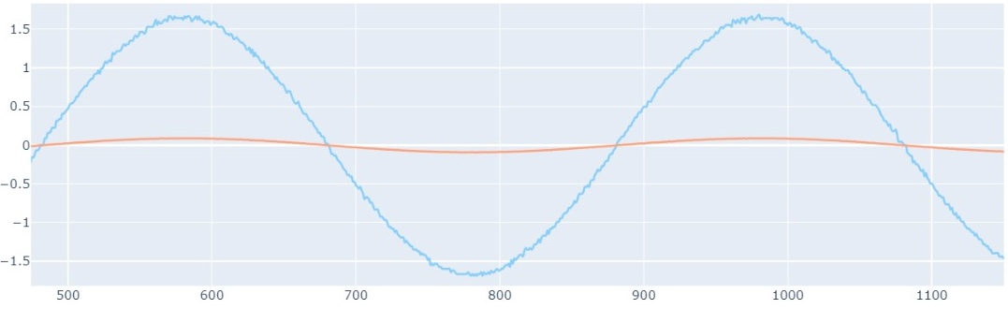
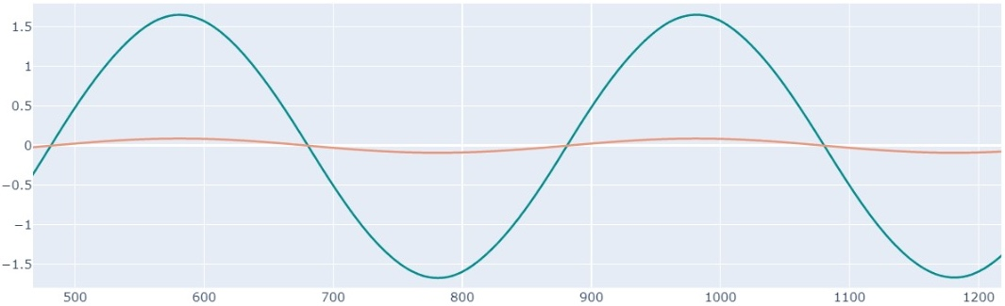
Lowpass Filtering
10 Cycle Window for 50 Hz
As per IEEE Standard 1564-2014
Why?
Removes high-frequency noise from the signal, making it easier to detect anomalies.
Before Filtering
After Filtering

Slide 31
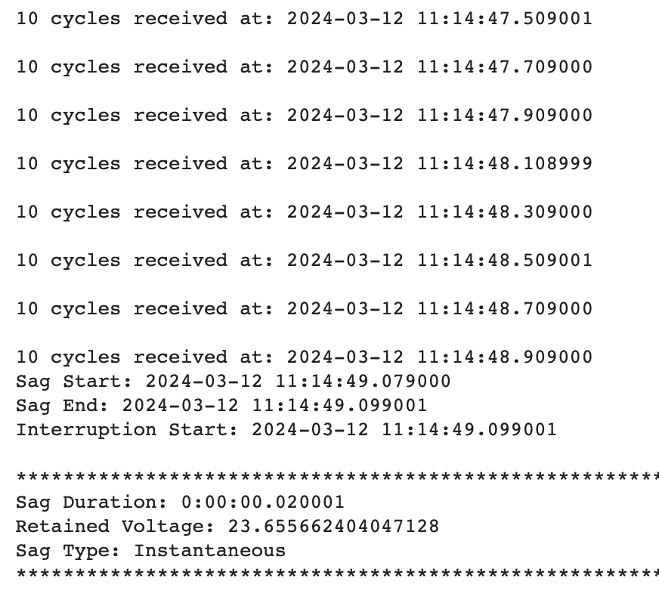
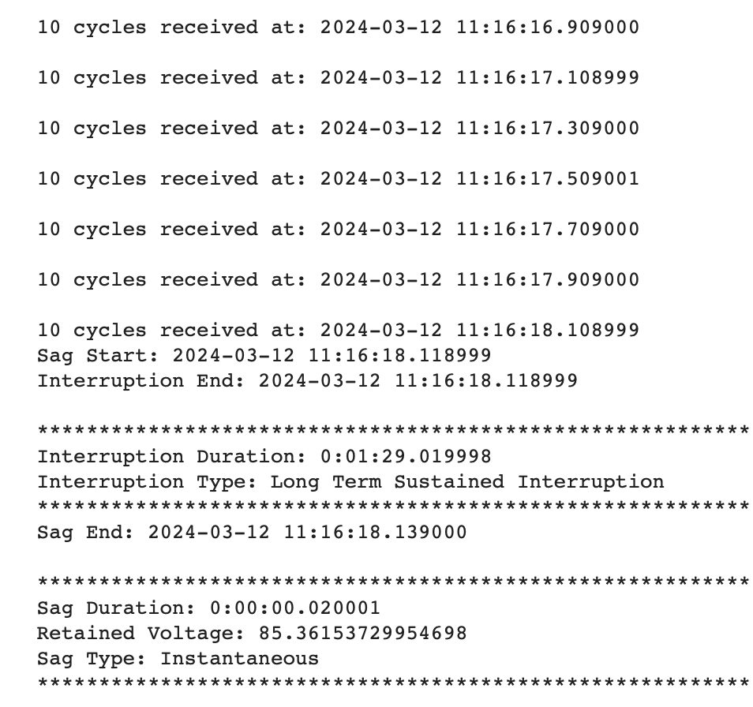
Results
Successful detection of RMS Variation Anomalies:

Slide 32
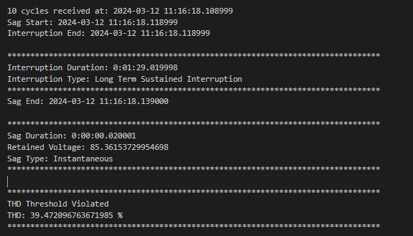
Results
Successful detection of THD Variation Anomalies:

Slide 33
REFERENCES
https://pyads.readthedocs.io/en/latest/index.html
https://www.beckhoff.com/en-en/products/automation/twincat/tc1xxx-twincat-3-base/tc1000.html
https://infosys.beckhoff.com/english.php?content=../content/1033/tcplclib_tc2_utilities/35010187.html&id=
https://download.beckhoff.com/download/document/automation/twincat3/TF6701_TC3_IoT_Communication_MQTT_EN.pdf
https://infosys.beckhoff.com/index.php?content=../content/1031/tcadsnetref/7312578699.html&id=
IEE Recommended Practice for Monitoring Electric Power Quality, The Institute of Electrical and Electronics Engineers, Inc. 345 East 47th Street, New York, NY 10017-2394, USA. Copyright © 1995 by the Institute of Electrical and Electronics Engineers, Inc.

